Slide 1
Stats High Dim
4.12.2024

Slide 2
Tasks
Add Woe Binning
Add Column City Population 2018
Add Column “has_codebtor”
Build function: calculate_metrics <- function(predicted_probs, actual_labels, threshold = 0.5):
Returns: Precission, Recall, F1, Accuracy
Build function find_optimal_threshold <- function(predicted_probs, actual_labels, thresholds)
Returns: Optimal threshold based on max F1
Build plot_metrics <- function(metrics): plots previous curves

Slide 3
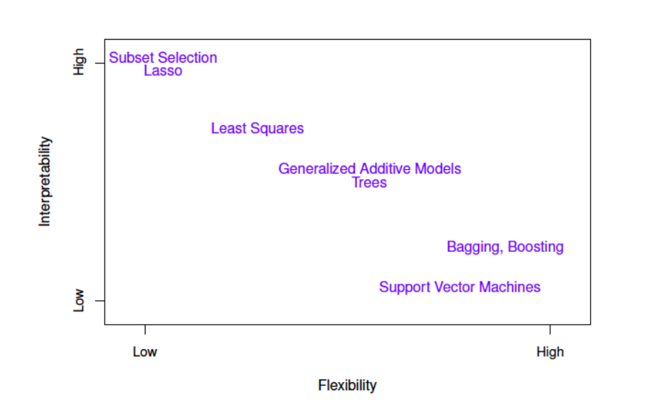
Complexity – Interpretability Tradeoff

Slide 4
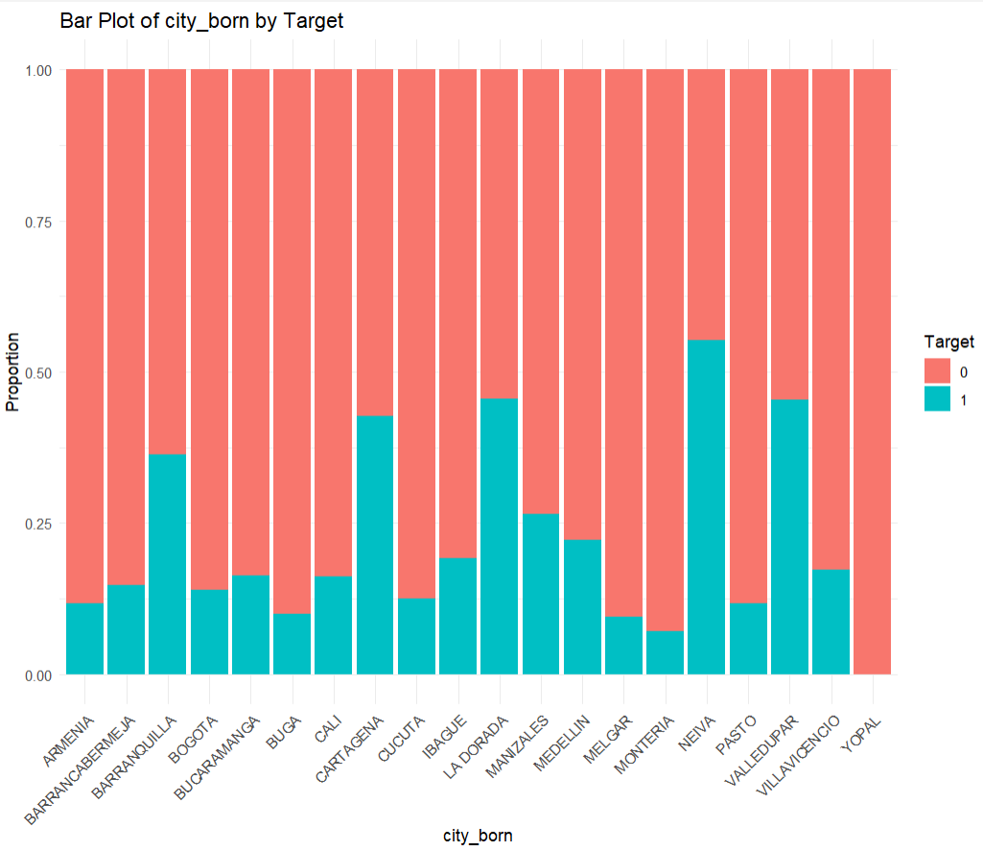
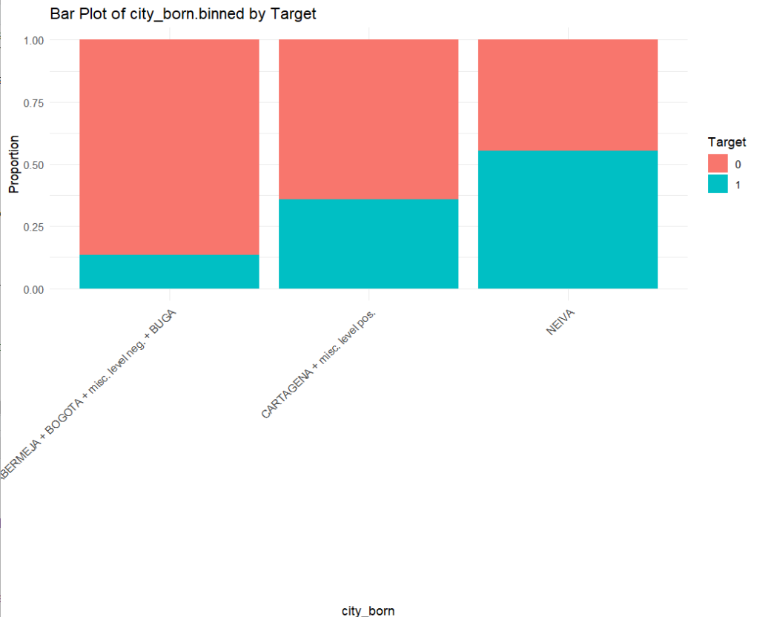
Binning
Merge factors within variable
Package woebinning
Before Binning
After Binning

Slide 5
Logit vs Binned Logit
Logit
Accuracy: 0.79
F1: 0.31
Binned Logit
Accuracy: 0.79
F1: 0.30
Doesn’t seem to be helpful in basic model

Slide 6
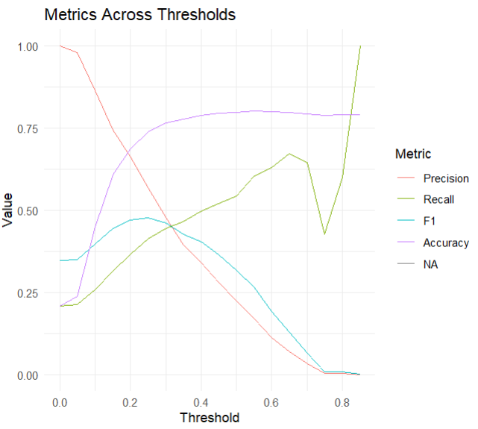
Fn: Find Threshold

Slide 7
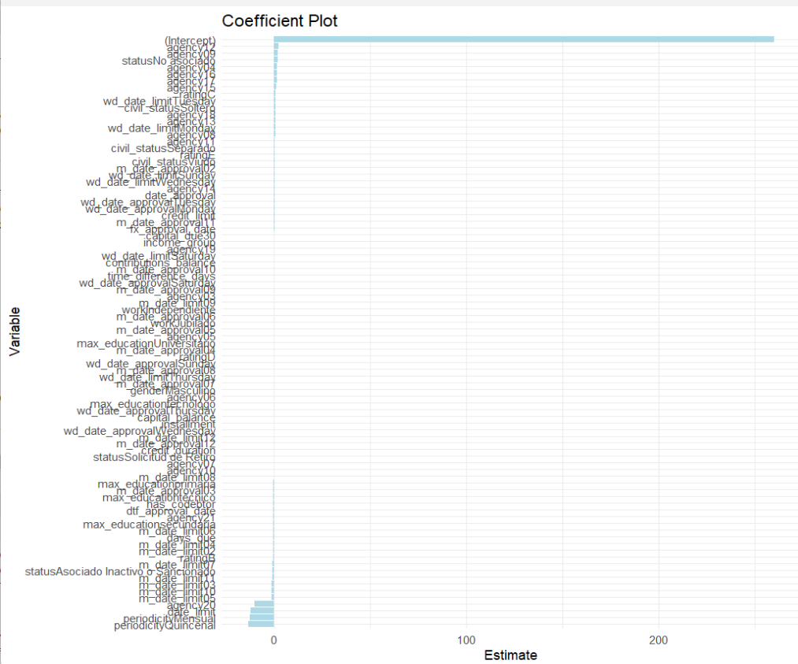
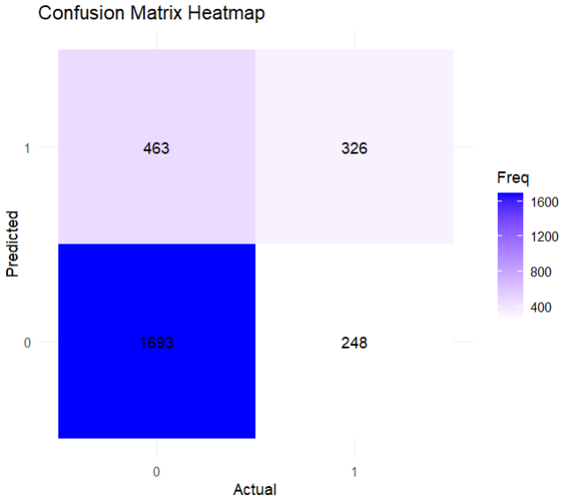
Logit Results
Threshold: 0.25
Accuracy: 0.73
F1: 0.47

Slide 8
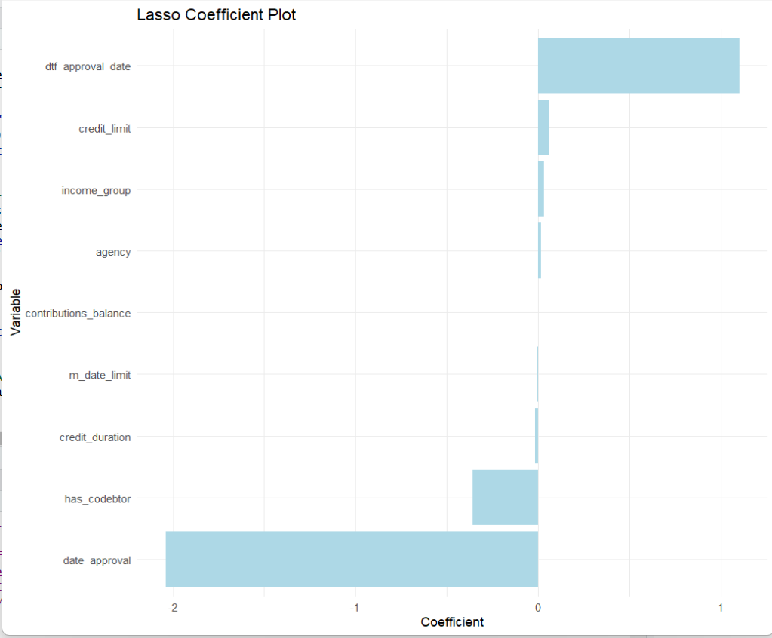
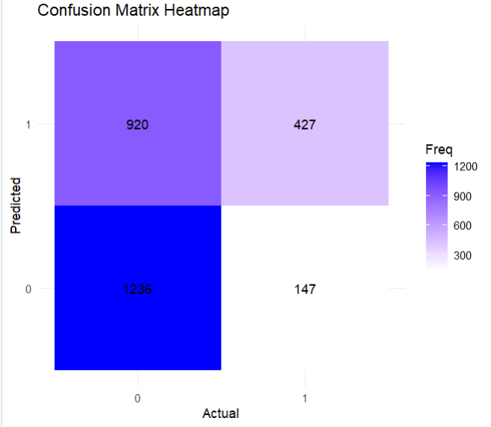
Lasso Results
Threshold: 0.15
Accuracy: 0.21
F1: 0.34

Slide 9
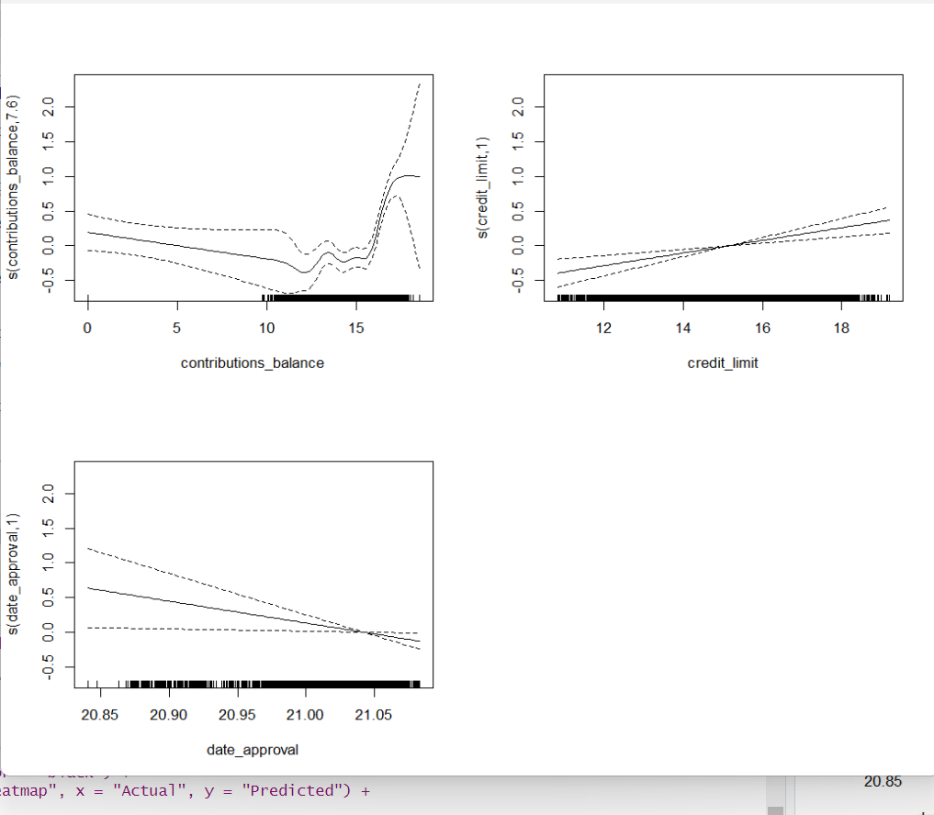
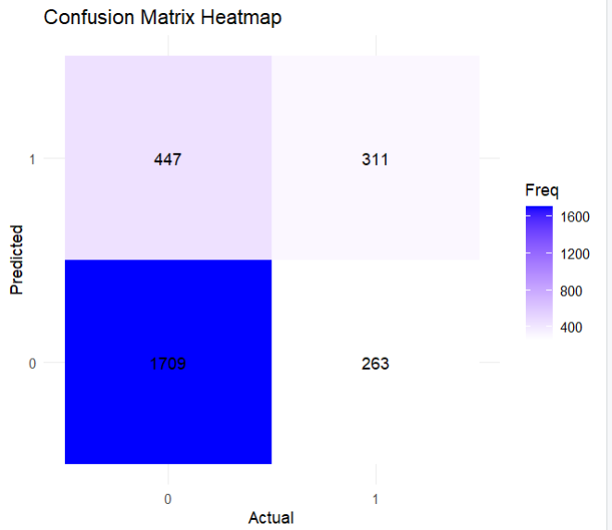
GAM Results
Threshold: 0.25
Accuracy: 0.73
F1: 0.46

Slide 10
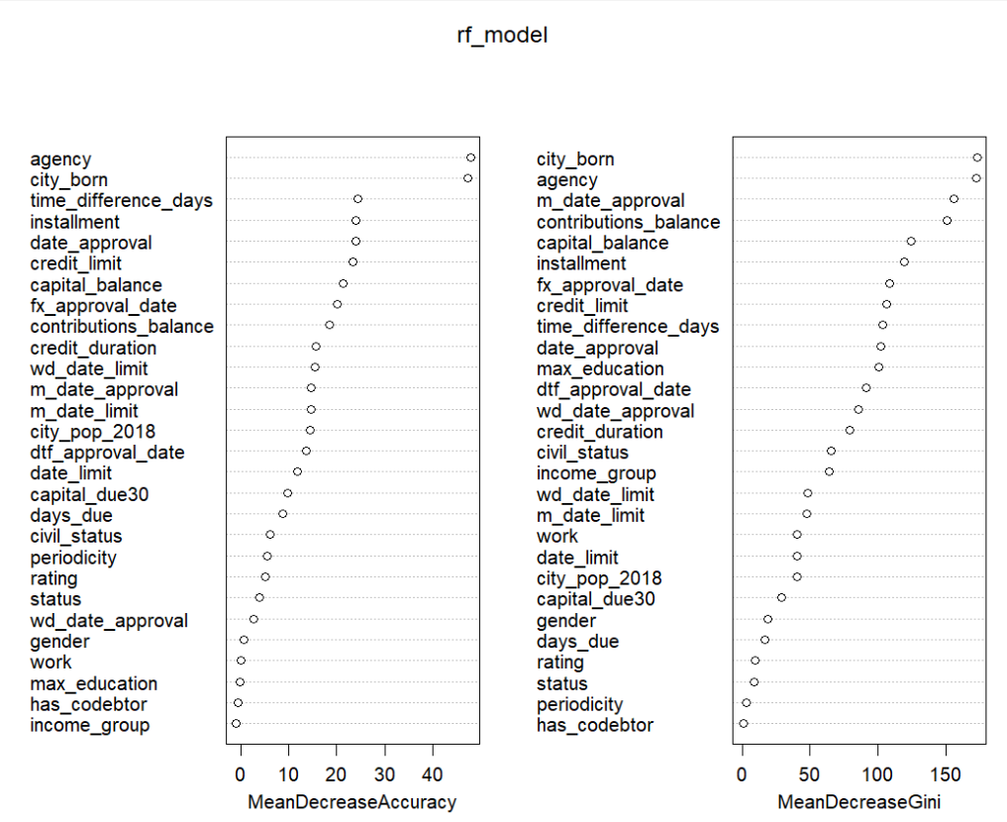

Random Forest Results
Threshold: 0.25
Accuracy: 0.80
F1: 0.31

